Slide 1
Instagram Clone Database
Key Features:
User profiles, follows, and connections.
Posting photos and videos with captions and hashtags.
Likes and comments tracking.
Analytics on user engagement and activity.

Slide 2
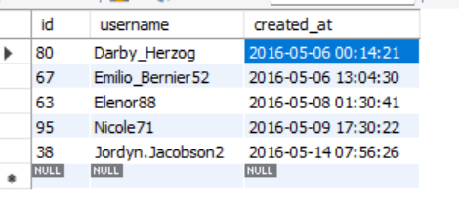
Find the 5 Oldest Users
SELECT *
FROM users
ORDER BY created_at
LIMIT 5;
Output :

Slide 3
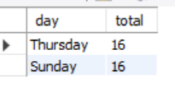
Find the Most Popular Registration Day
SELECT
DAYNAME(created_at) AS day,
count(*) AS total
FROM users
GROUP BY day
ORDER BY total DESC
LIMIT 2;
Output :

Slide 4
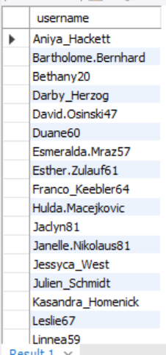
Find Users Who Have Never Posted a Photo
SELECT username Output :
FROM users
LEFT JOIN photos
ON users.id=photos.user_id
WHERE photos.id IS NULL;

Slide 5

Contest for the Most Liked Photo
SELECT
username,
photos.id,
photos.image_url,
count(likes.user_id) AS total
FROM photos
INNER JOIN likes
ON likes.photo_id=photos.id
INNER JOIN users
ON photos.user_id = users.id
GROUP BY photos.id
ORDER BY total DESC Output
LIMIT 1;

Slide 6
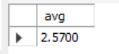
Average Number of Posts per User
SELECT
(SELECT COUNT(*) FROM photos) / (SELECT COUNT(*) FROM users) AS avg;
Output :

Slide 7
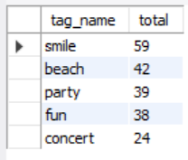
Find Top 5 Most Used Hashtags
SELECT
tags.tag_name,
COUNT(*) AS total
FROM photo_tags
JOIN tags
ON photo_tags.tag_id= tags.id Output
GROUP BY tags.id
ORDER BY total DESC
LIMIT 5;

Slide 8
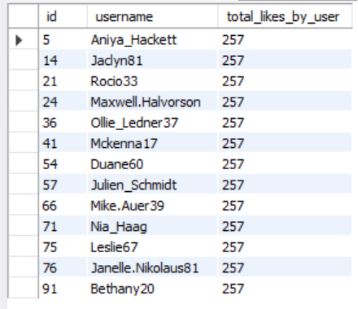
Find Users Who Have Liked Every Photo
SELECT users.id,username, COUNT(users.id) AS total_likes_by_user
FROM users
JOIN likes ON users.id = likes.user_id
GROUP BY users.id
HAVING total_likes_by_user = (SELECT COUNT(*) FROM photos);
Output :

Slide 9

Find Users Who Have Never Commented
SELECT username,comment_text
FROM users
LEFT JOIN comments ON users.id = comments.user_id
GROUP BY users.id
HAVING comment_text IS NULL;
Output :

Slide 10
Find Users Who Have Never Commented or Commented on Every Photo
SELECT tableA.total_A AS 'Number Of Users who never commented',
(tableA.total_A/(SELECT COUNT(*) FROM users))*100 AS '%',
tableB.total_B AS 'Number of Users who commented on photos',
(tableB.total_B/(SELECT COUNT(*) FROM users))*100 AS '%'
FROM
(
SELECT COUNT(*) AS total_A FROM
(SELECT username,comment_text
FROM users

Slide 11
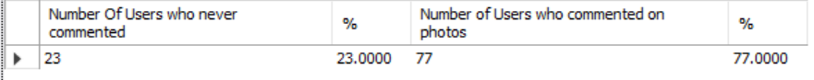
(SELECT username,comment_text
FROM users
LEFT JOIN comments ON users.id = comments.user_id
GROUP BY users.id
HAVING comment_text IS NULL) AS total_number_of_users_without_comments
) AS tableA
JOIN
(
SELECT COUNT(*) AS total_B FROM
(SELECT username,comment_text
FROM users
LEFT JOIN comments ON users.id = comments.user_id
GROUP BY users.id
HAVING comment_text IS NOT NULL) AS total_number_users_with_comments
)AS tableB;
Output

Slide 12
THANK YOU
RAVI KUMAR

